Slide 1
Research Paper Presentation
Stroke detection by image segmentation with Residual U-Net
Presenter
Presentation Date

Slide 2
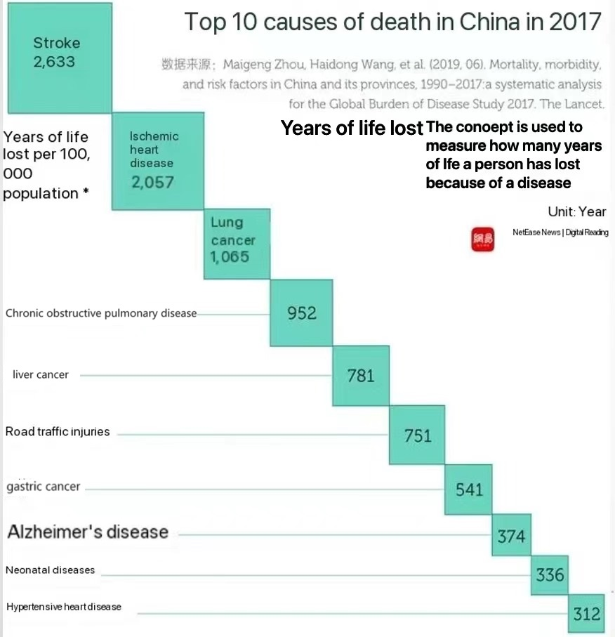
Background
Global Stroke Burden
Stroke: 2nd Leading Cause of Death, 3rd Leading Cause of Disability Worldwide
Importance of Early Detection
Early Detection Saves Lives
Improves Survival Rates
Enhances Quality of Life
Reduces Long-term Disability Risks
Existing Challenges
Dependence on Professional Diagnosis
Need for Rapid, Accurate Automated Detection Methods
Complexity in Medical Imaging

Slide 3
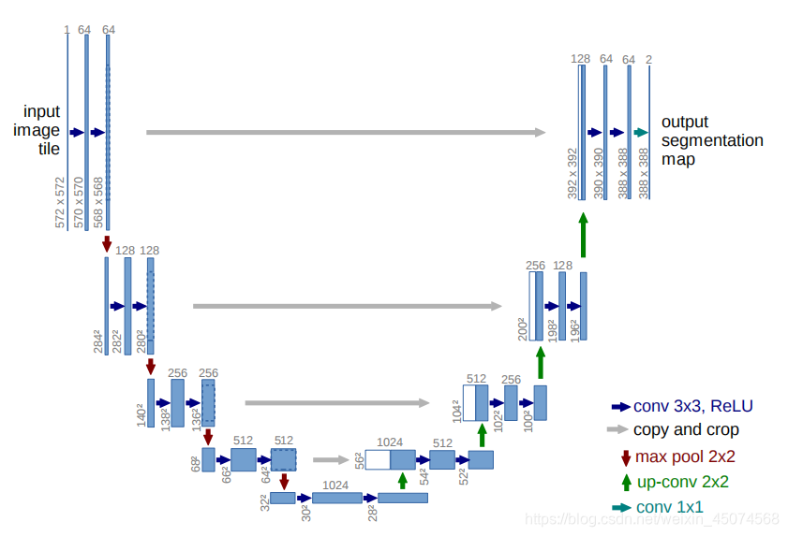
Background
Robust performance even with limited training data
Efficient utilization of computational resources
Adaptability to various medical imaging modalities
The U-Net architecture is widely applied

Slide 4
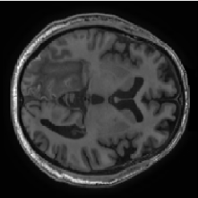
Datasets
ATLAS v2.0 Dataset
The ATLAS v2.0 dataset is a key component in the research, featuring:
955 MRI images for training and testing.
Manually segmented masks for accurate lesion identification.
Global cohort representation for dataset diversity.
Open-access availability to researchers.
Use in evaluating the performance of the Residual U-Net model for stroke detection.
Notes:
=

Slide 5
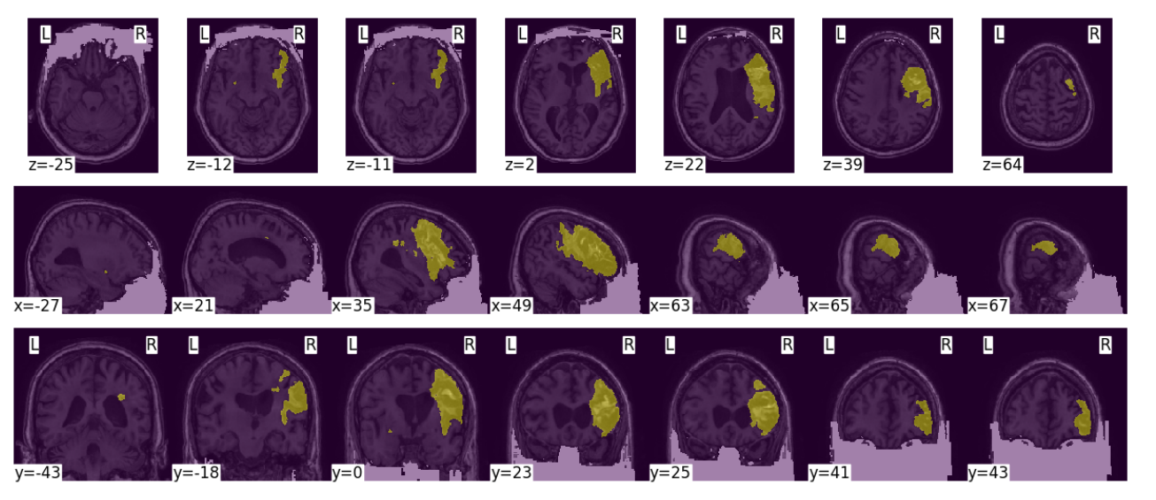
Result
prepare Data
Annotated Images: 655 images with masks for precise segmentation in the ATLAS v2.0 dataset.
Test Images: 300 images for evaluating model performance.
Data Split: Dataset divided into training (60%), validation (20%), and testing (20%) sets.
Slicing: Each 3D sample converted into 100 2D images for processing.
Batch Selection: Batches selected from samples between index 70 and 90.
Data Augmentation: Techniques like normalization, flipping, rotation, and zooming applied to increase dataset size and variability.
Augmentation Repetition: Augmentation process repeated three times to expand training dataset.
Notes:
=

Slide 6
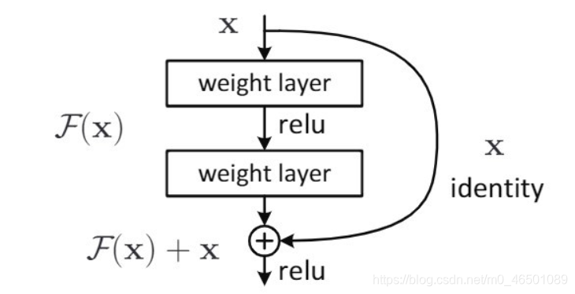
Methodology
Res-Block
Mitigates gradient vanishing
Facilitates training deep networks
Speeds up training convergence
Improves gradient flow
Efficiently captures small changes
Enhances feature learning
Addresses degradation in deep networks
Facilitates feature reuse
Boosts model performance
Compatible with various architectures
Useful across different domains
conv2d
Unet
convtranspose2d
max pooling
concatenate
Notes:
卷积层用于提取图像细节和抽象信息，实现参数共享；池化层能缩减特征图尺寸，起到降维效果，减少数据大小；全连接层执行最终分类任务。

Slide 7
Methodology
Res-Unet
conv2d
convtranspose2d
batchnormalization
Residual Blocks: Enable deep network training by learning residual connections, addressing vanishing gradients and speeding up convergence.
Batch Normalization: Stabilizes learning and accelerates training by normalizing each layer's input, enhancing the network's feature learning capability.
concatenate
add
activation
Notes:
卷积层用于提取图像细节和抽象信息，实现参数共享；池化层能缩减特征图尺寸，起到降维效果，减少数据大小；全连接层执行最终分类任务。

Slide 8
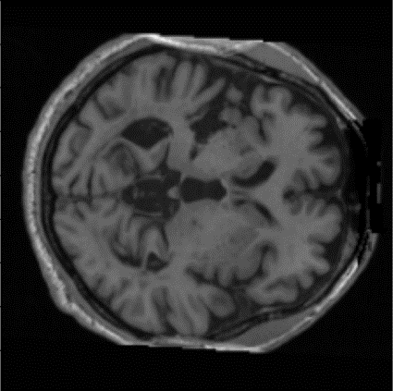
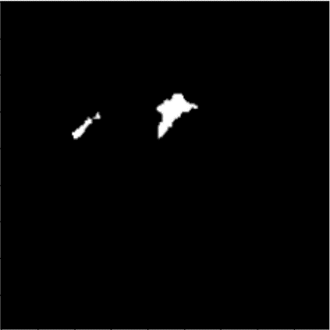
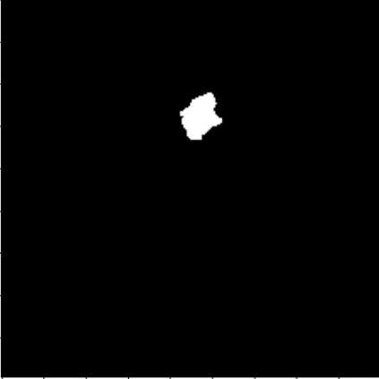
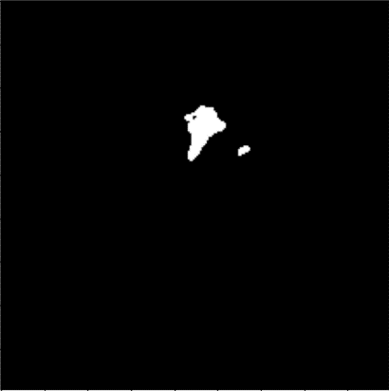
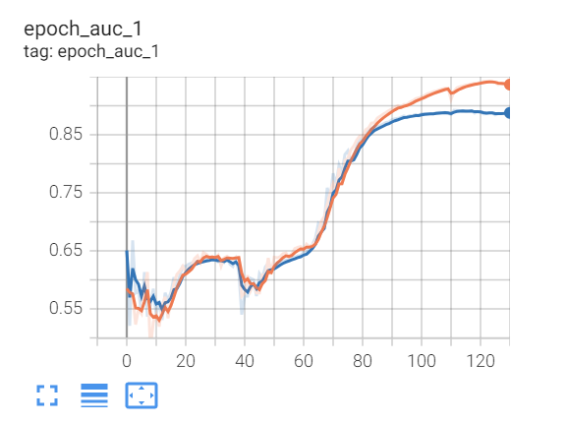
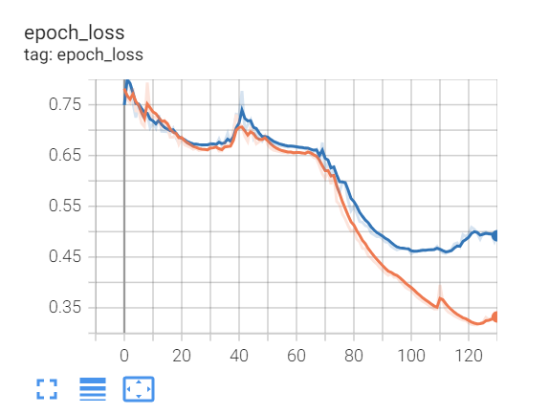
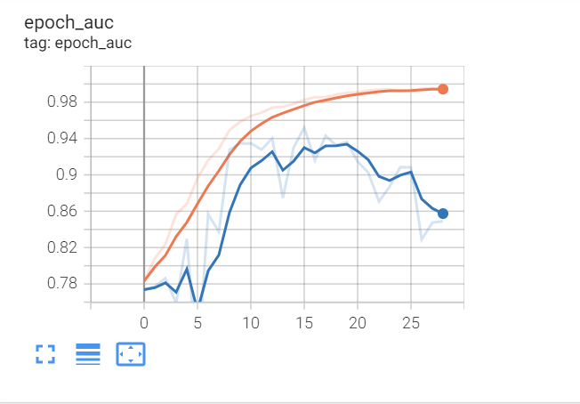
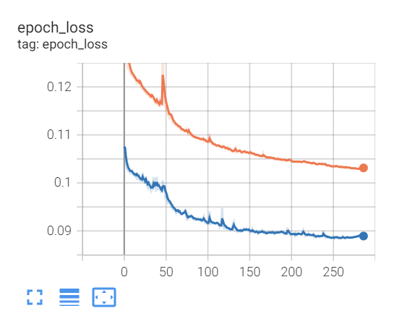
Result
original picture
groundtruth
Unet prediction
Res-Unet prediction
Unet auc
Unet loss
Res-Unet auc
Res-Unet loss
Notes:
=

Slide 9
Conclusion
Conclusion
The Residual U-Net model significantly improves stroke detection accuracy in MRI images.
The model outperforms traditional U-Net due to its ability to capture deeper features while preserving details.
The ATLAS v2.0 dataset's diversity and quality facilitate a robust evaluation of the model's performance.
The method is deemed suitable for clinical applications requiring precise and swift stroke detection.

Slide 10
Conclusion
Improvements
Increase dataset diversity to encompass a broader range of patients and stroke types.
Optimize model for real-time processing to meet clinical settings' time-sensitive demands.
Integrate the model into clinical workflows for seamless adoption.
Conduct cross-validation for model robustness and to prevent overfitting.
Explore advanced techniques like attention mechanisms for better pattern recognition.
Enhance model explainability to improve clinical trust and acceptance.

